Slide 1
NDOM
https://minerals.nv.gov/Program
Oil and Gas Permits and Forms
Geothermal Permits and Forms
DMRE Permits and Forms
NDOM Open Data Site
https://data-ndom.opendata.arcgis.com/
Well locations and lease maps
Production and Well Data
NBMG
https://nbmg.unr.edu
Oil and gas logs and data
Geothermal logs and data
Scientific publications
NBMG Open Data & GBCGE Subsurface Database
https://data-nbmg.opendata.arcgis.com/pages/web-applications
Maps
Data
Notes:
NDOM focuses on regulatory and fluid mineral resource management, the responsibility for well data provision lies with the NBMG Great Basin Science Sample and Records Library (Gold Building).
It is fully recognized that there has been a breakdown in the sharing of well data due to staffing and funding shortages. NBMG and NDOM rely on adequate staffing and funding to efficiently collect, manage, and share well data. Unfortunately, limited resources have led to constraints in providing well data coverage, but we are actively working on a more efficient means of sharing well data.
That said, if you cannot find what you are looking for at the Gold Building I can try and provide you with what files we have in digital form, but it may take some time. You are also welcome to come down to our office and scan what files we have that are non-confidential.

Slide 2
Oil, Gas, and Geothermal
Regulatory agency for drilling in Nevada
Approves drilling and completion programs
Oversees drilling and subsequent completion operations through daily reporting
Approve maintenance and work-over operations
Approves the final plugging and abandonment of well
Inspects wells after completion
Tabulates production and injections data submitted by operators on a monthly basis.
Notes:
The Nevada Division of Minerals is the state’s regulatory authority for all oil and gas wells drilled in Nevada. Oil and gas wells drilled within Nevada, on either private or federally managed lands, must be permitted by the Nevada Division of Minerals. The associated drilling and completion programs must be approved by the Division before either program is implemented. The Division oversees the drilling and subsequent completion operations through daily reporting to the Division by the operator, as well as inspect the wells after they are completed. The Division must also approve all maintenance and work-over operations during the life of the well, as well as the final plugging and abandonment of a well at the end of its useful life. Oil and gas production and injection information is submitted to the Division on a monthly basis, where the information is tabulated both monthly and annually.

Slide 3
State of Nevada’s Oil, Geothermal, and Dissolved Minerals Activity
2023
Nevada Petroleum and Geothermal Society
Dustin Holcomb
Fluid Minerals Program Manager
Nevada Division of Minerals
Notes:
My presentation will be geared toward discussing the permitting and drilling activity in the state, for the last year, at least since I took over.

Slide 4
Mike Visher
Retired
September 2023
He was with the Division from 2005-2023
Rob Gighlieri
New Administrator of NDOM
Notes:
Mike is enjoying his well-deserved retirement after ~18 years with the Division.
With Mike’s retirement we have lost some institutional knowledge, no doubt about that
but I can assure you that we do not plan to change the way in which the Division operates.

Slide 5
Nevada Division of Minerals
Mission -
To encourage and assist in the responsible exploration for and the production of minerals, oil, gas, and geothermal energy
Provide for public safety by identifying, ranking and securing dangerous conditions at mines that are no longer operating
Collecting and disseminating information on exploration, production, and related topics.
Statutes
NRS & NAC 522 – Oil and Gas
NRS & NAC 534A – Geothermal Resources
NRS & NAC 534B – Dissolved Mineral Resource Exploration
Source of Funding -
Fees and assessments from the oil, gas, and geothermal industries.
No State general funds in the division's budget.
Notes:
Overseen by a Commission on Mineral Resources
Nevada is a member of the Interstate Oil and Gas Compact Commission.
AML program

Slide 6
Active Oil Leases in Nevada on Federal Lands
Notes:
742 Well oil wells drilled
120 Open Wells
65 Producers Active Wells
40 Producers Shut In
12 Active Injection Wells
3 Shut In Injection Wells
7 Orphan Wells(BLM surface)
Discuss: oil production for this year. On track or not?

Slide 7
Oil Exploration Drilling and Permitting
West Grant Canyon Development, LLC - Railroad Valley, Nye County
Butterfield Federal 1, approved June 2019, Completed & Plugged June 2023
Great Basin Operating, LLC – North Diamond Valley, Elko County
North Diamon Valley 1-27, Approved July 2022, Temp-Abandoned September 2023
Hussey Oil & Gas Ventures, LLC- Grant Canyon, Nye County
Permitted Soda Spring 1-22, approved February, expires in 2025
,
Hussey Oil & Gas Ventures, LLC- Grant Canyon, Nye County
Permitted North Grant Canyon 1-8, approved February, expires in 2025
Permit Type | Issued | Drilled | Issued | Drilled | Issued | Drilled | Issued | Drilled | Issued | Drilled | Issued | Drilled
Year | 2018 | 2018 | 2019 | 2019 | 2020 | 2020 | 2021 | 2021 | 2022 | 2022 | 2023 | 2023
Oil & Gas | 3 | 1 | 3 | 1 | 4 | 3 | 1 | 2 | 1 | 1 | 2 | 2
Notes:
Most
Bill Ehni &

Slide 8
Future of Oil in Nevada
• Reserves continue to decline-new discoveries could reverse this trend.
• Geology of Nevada makes large new field discoveries difficult because of highly faulted and complex stratigraphy, plus volcanics can interfere with seismic
interpretation.
• Higher prices due to global instability could entice out of state operators to explore Nevada.
• New techniques to extract from existing fields could increase production.
• Inflation Reduction Act will change Onshore Oil & Gas leasing rules on Federal land
Notes:
What makes Nevada great for geothermal, makes it poor for oil and gas.
Extension of the North American Plate that has lead to a thin crust with a high temperature gradient and all of the normal and thrust faulting.
Tends to have overcooked the oil and led to compartmentalization of the oil

Slide 9
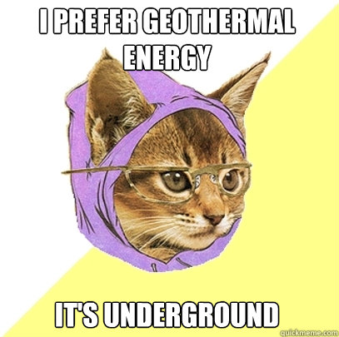
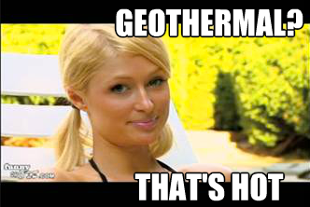
Geothermal
Notes:
A quick google search will find you some pretty awful memes for ge0thermal

Slide 10
Notes:
Histogram of the last 38 years comparing Permitted/Drilled wells per year.
2023:
16 Permitted
14 Drilled
2022
32 Permitted
18 Drilled

Slide 12
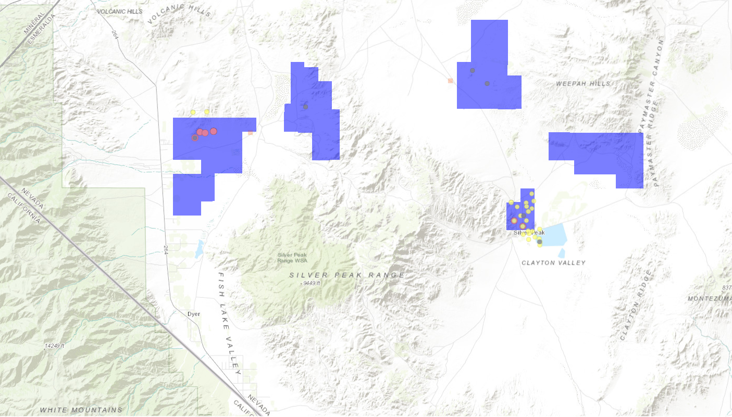
Esmeralda County Activity
Fish Lake Geothermal
6 Permits
1 – Production Well Completed
Lone Mountain
5 - Permits
4 – Thermal Gradient Completed
1 – Observation Well ReEntry
Pearl Project
6 – Permits
3 – Observation Wells Completed
Notes:
Fish Lake:
Ownership of 2 completed older wells
Drileld 2 production wells
Pending 2 injection wells

Slide 13
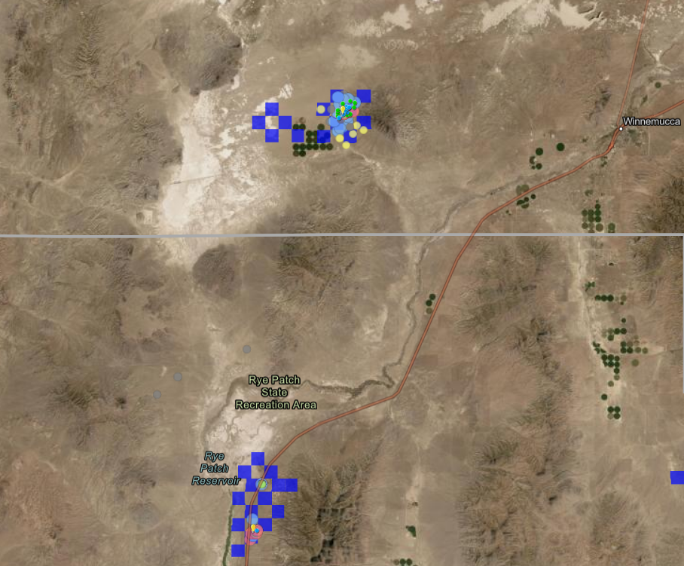
Pershing/Humboldt County Activity
Star Peak Geothermal
4 – Permits
1 – Production Well completed
Fervo & Cyrq Blue Mountain
2 – Well Development

Slide 14
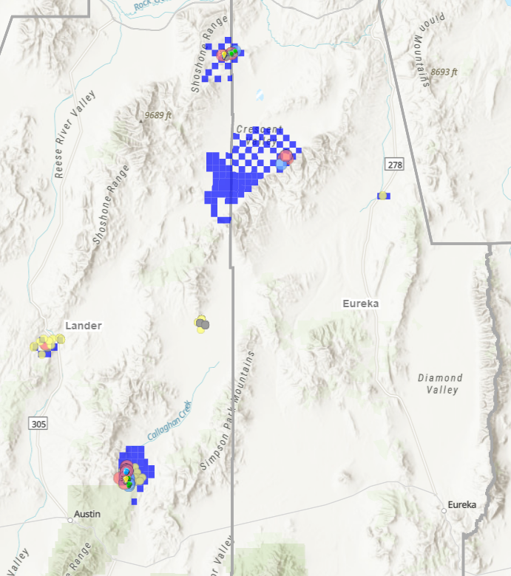
Lander/Eureka County Activity
McGinness Hills
1 – Production Well
Beowawe
1 – Permit
1 – Well Completed
Whirlwind Project
6 – Permits
Notes:
Fish Lake:
Ownership of 2 completed older wells
Drileld 2 production wells
Pending 2 injection wells

Slide 15
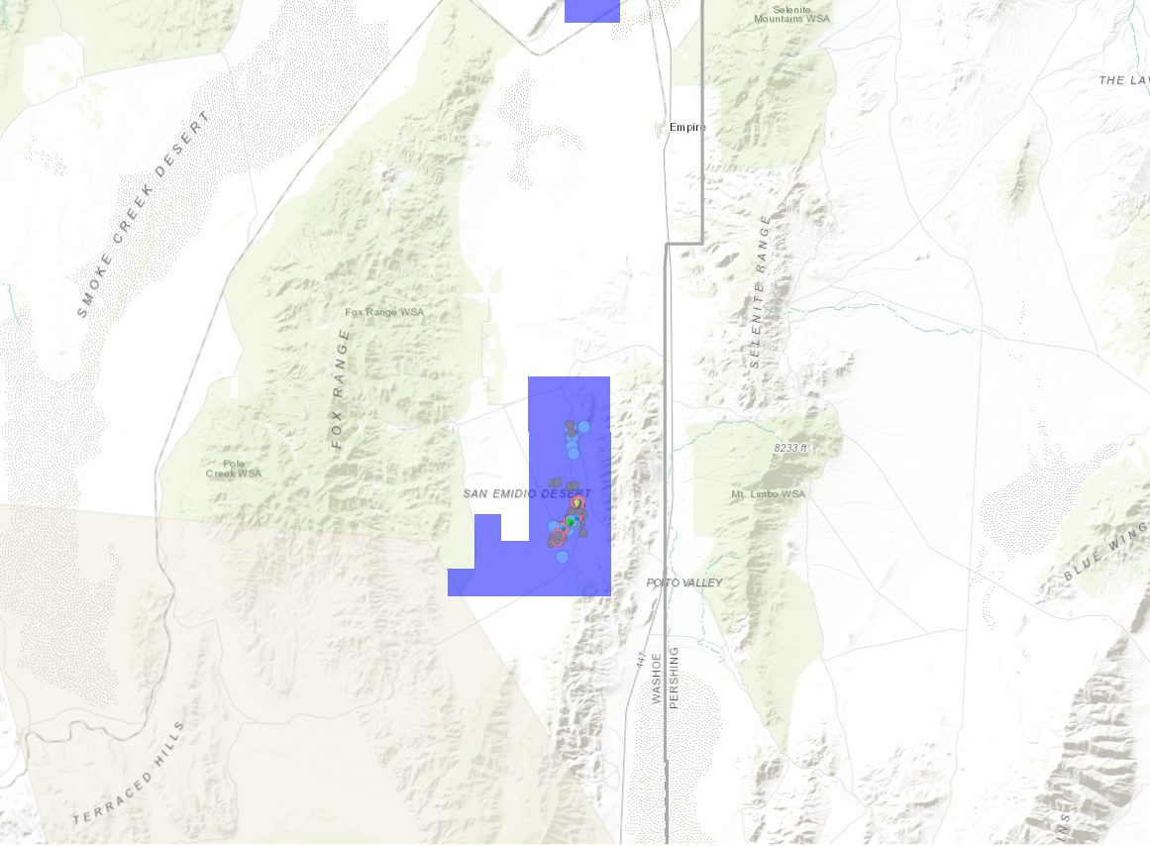
Washoe County Activity
San Emidio Desert
Commissioned North Valley Power Plant
Notes:
Fish Lake:
Ownership of 2 completed older wells
Drileld 2 production wells
Pending 2 injection wells

Slide 16
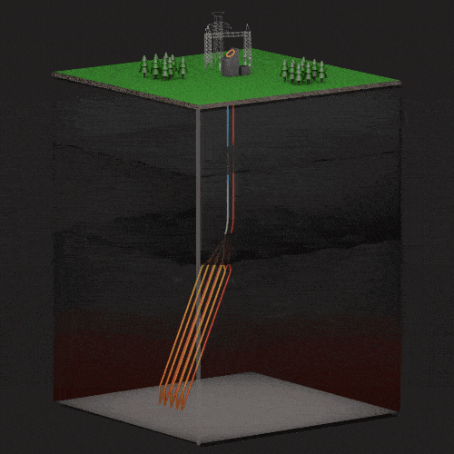
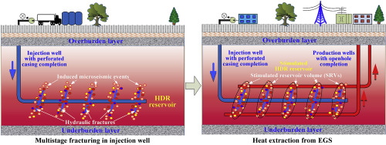
Future of Geothermal in Nevada
• Continued exploration of traditional geothermal systems.
• EGS- Enhanced Geothermal System, closed loop and hydraulically stimulated
systems, combination of solar and geothermal systems.
• Improved power plant efficiency.
• More remote areas available due to increased infrastructure(NV Energy Greenlink).
• Government funded projects in existing oilfields.
• Lithium extraction from brine water.
https://www.sciencedirect.com/science/article/abs/pii/S0960148119316118
https://www.eavor.com/

Slide 17
Dissolved Mineral Resource Exploration (DMRE)
Assembly Bill 52 of 2017
The purpose:
Define a permitting path for dissolved mineral exploration
Develop regulations to ensure exploration drilling for dissolved minerals is protective of groundwater, as well as oil and geothermal resources.
https://minerals.nv.gov/Programs/DMRE/DMRE/
Notes:
Division task with creating a permitting path for dissolved mineral exploration due to the demand for lithium

Slide 18
Dissolved Mineral Resource Exploration
DMRE Borehole Notice of Intents – 16
DMRE Well Permits –4
Usha Resources – 2
Origin Minerals – 2
Wells Pumped this year – 3
Cumulative Acre-Feet: 4.5
W0007
W0008
W0017
Notes:
Usha had 2 collapsed wells
1 redrill, 1 redrill permitted
GeoXplore drilled 1 well, permitted in 2022

Slide 19
Esmeralda County Activity
DMRE Drilling
Total in Esmeralda:
10 Exploration Wells
39 Exploration Boreholes
GeoXplor
1 – Borehole, Clayton Valley
1 – Exploration Well, Clayton Valley
Intor Resources
2 – Boreholes, Lida Valley
Dome Rock Resources
8 – Borehole, Lida Valley
Morella Minerals
4 – Boreholes, Fish Lake Valley
Notes:
15 Boreholes NOI
1 Exploration Wells drilled this year

Slide 20
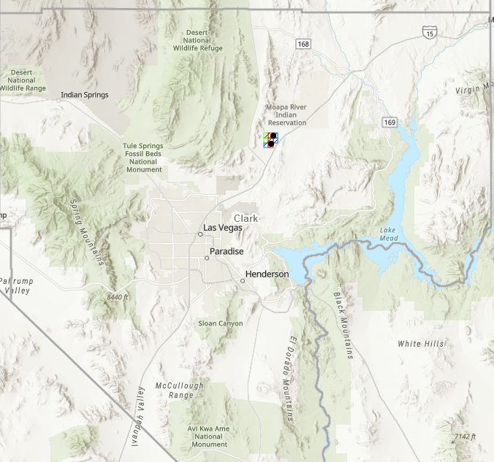
Clark County Activity
DMRE Drilling
Total:
4 Exploration Wells
0 Exploration Boreholes
Usha Resources
3 – Exploration Wells, Garnet Valley
Notes:
Drilled 3
2 ReDrills
Not Drilled 1

Slide 21
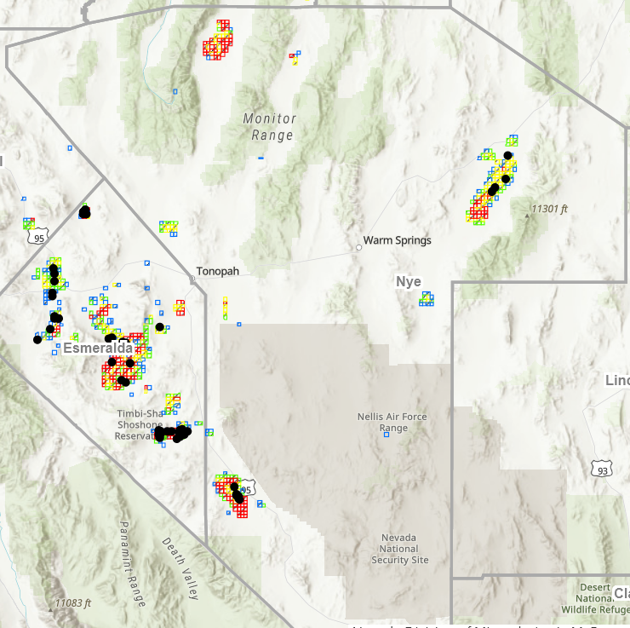
Nye County Activity
DMRE Activity in 2023
Total:
2 Exploration Wells Permitted
1 Exploration Boreholes
Origin Minerals
2 – Exploration Wells, Big Smokey Valley
Ionic Minerals (Bonaventure)
1 – Borehole, Sarcobatus Flat
3PL Operating
2 – Exploration Wells, Railroad Valley
Actively Pumping
Notes:
Origin Minerals - 2 Exploration Wells were permitted

Slide 22
Future of Dissolved Mineral Resource Exploration in Nevada
• Increase in demand and price of lithium.
• Direct lithium extraction, removes need for evaporation ponds and provides timely production of high-grade lithium.
• Exploration of new claims.
• Government support to become more dependent on domestic lithium resources.

Slide 23
Thank you
Nevada Division of Minerals
Rob Ghiglieri
Administrator
rghiglieri@minerals.nv.gov
Dustin Holcomb
Fluid Minerals Program Manager
dholcomb@minerals.nv.gov
Lucia Patterson
Geologist - GIS Analyst IV
lmpatterson@minerals.nv.gov

